Slide 2
Single-day PCR diagnosis of ASFV in a resource-limited endemic setting in Uganda
EZINGA Richard
Uganda; NARO-NaLIRRI

Slide 3
Agenda
ASF Country situation: Endemic – Multiple untracked outbreaks
Key challenges faced:
Diagnosis-Hard to pick all outbreaks
Limited resources (Funding and priority)
Technical limitation (Conventional PCR; No RDT for screening)
Vision for the swine sector in your country for the next 5 years/10 years:
Track as many outbreaks as possible-capture the genomic changes
Attempting to develop a vaccine that matches genotype IX and X ASFVs
Expectations from this ASF GAP Analysis:
Best practices and Networking
Funding collaborations

Slide 4
Research team
Ezinga, Richard^{1,2}; Kabaka, Richard, M¹; Birungi, Grace¹; Asiku, Kelvin ¹; Namazzi, Betty, P¹; Nangonzi, Rosette¹; Tusubira, Deusdedit ²; Swidiq, Mugerwa¹; Kabuuka, Tonny ^{1,} #

Slide 5
Aim: Track as many ASF outbreaks as possible
Notifiable pig disease caused by the African swine fever virus
Significant effect on country’s economic growth
(loss of revenue and production)
Multiple unreported outbreaks in the country
Screening and diagnosis still a challenge
No vaccine yet

Slide 6
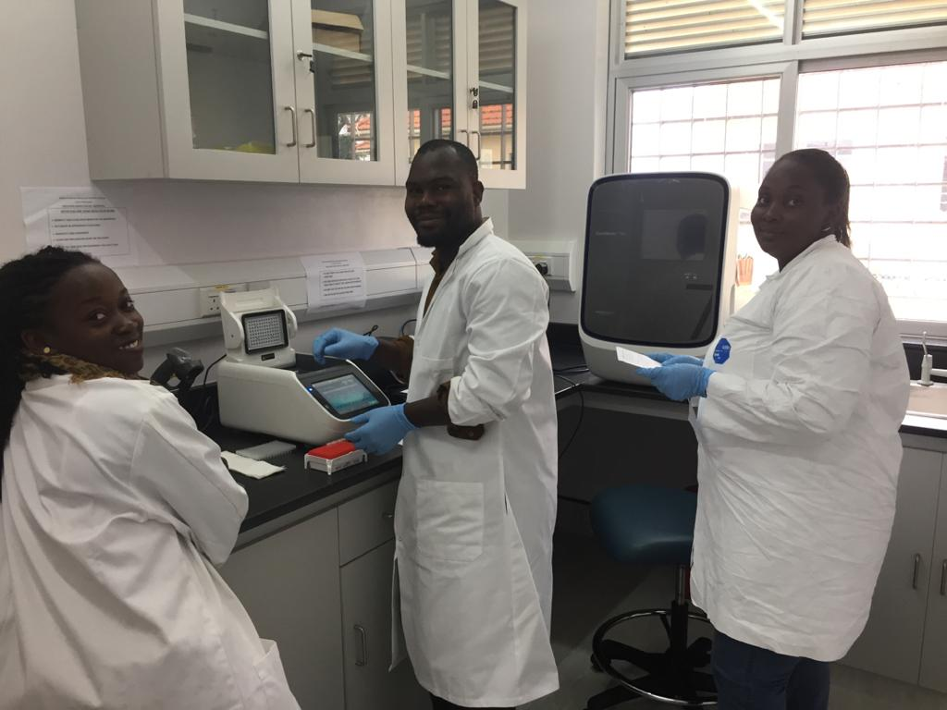
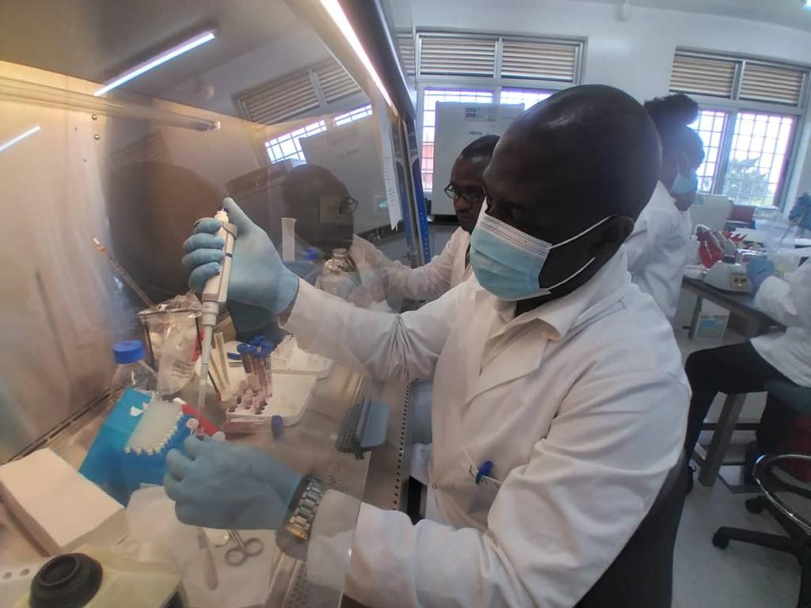
Methodology
400 samples
p72 gene PCR
Other markers (TK, 9GL and DUT genes)

Slide 7
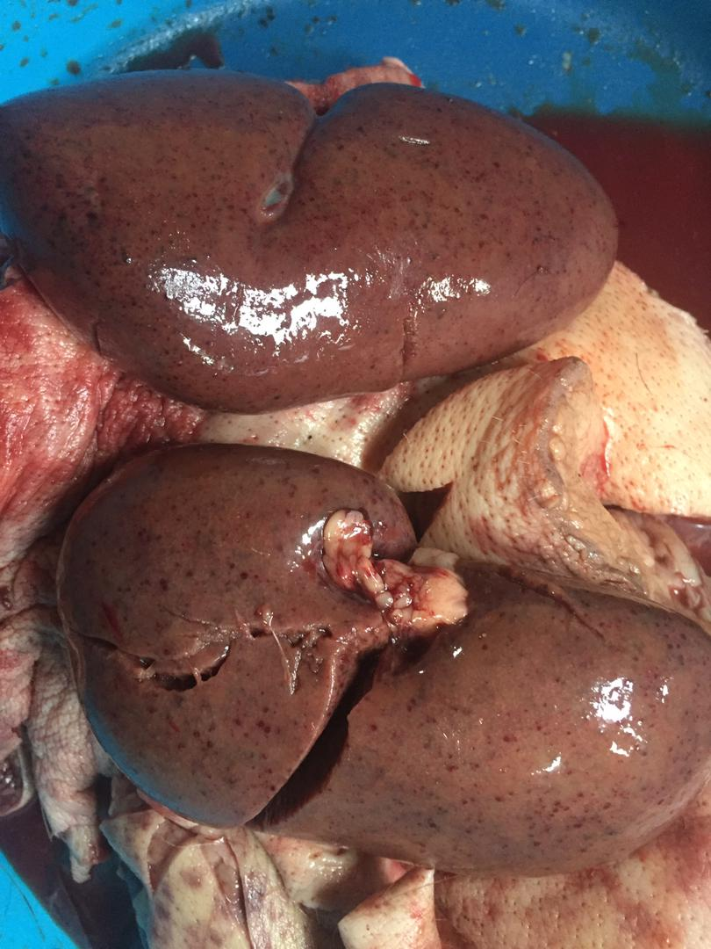
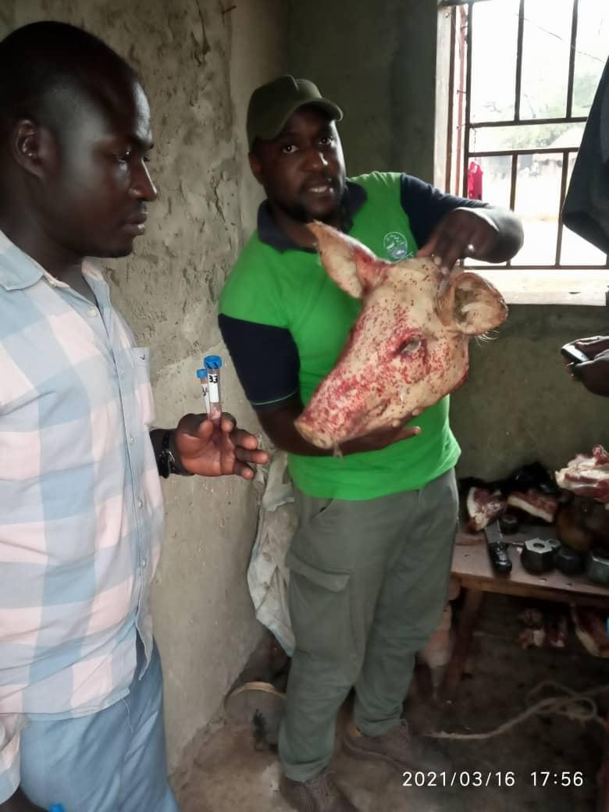
Results

Slide 8
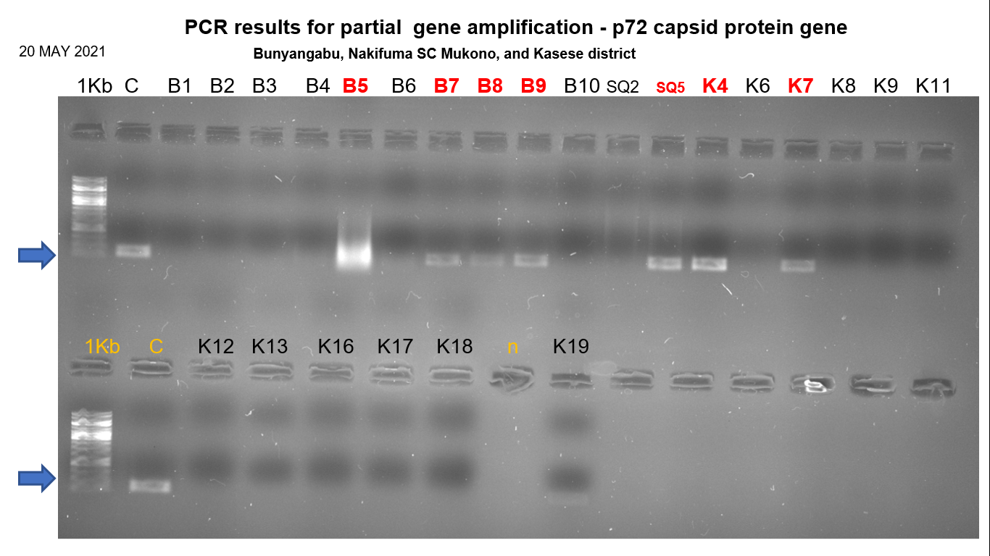

Slide 10
Discussion
Collected 400 tissue samples across Uganda
Obtained 21 positives from 5 districts in three sub-regions of Uganda
Begun with a TAT of 48 hours, however, due to an outbreak on a larger farm
Adjusted the protocol to a TAT of 8 hours

Slide 11
Conclusion
Modified the time to diagnose ASF from 48 to 8 hours using conventional PCR
Results used for selection of primary virus for planned vaccine development work

Slide 12
Manuscript in Preparation
Single-day PCR diagnosis of ASFV in a resource-limited endemic setting in Uganda. Ezinga, Richard^{1,2}; Kabaka, Richard, M¹; Birungi, Grace¹; Asiku, Kelvin ¹; Namazzi, Betty, P¹; Nangonzi, Rosette¹; Tusubira, Deusdedit ²; Swidiq, Mugerwa¹; Kabuuka, Tonny ^{1,} #

Slide 13
Acknowledgement
Government of Uganda
NARO-NaLIRRI

Slide 15
Cell-culture mediated isolation of African Swine Fever field viruses for vaccine production in Uganda
Presenter: Samuel Mulondo
Country and institution: Uganda, NARO-NaLIRRI

Slide 16
Agenda
What is the country situation with respect to ASF? (Endemic)
What are some of the key challenges faced?
(Diagnosis-Hard to pick all outbreaks; Limited resources; Technical limitation-Most do conventional PCR; No RDT for screening)
What is your vision for the swine sector in your country for the next 5 years/10 years?
(Track as many outbreaks as possible-capture the genomic changes; Attempting to develop a vaccine that matches genotype IX and X ASFVs)
4. What are your 3 – 5 expectations from this ASF GAP Analysis?

Slide 17
ASF Research team
Samuel Mulondo
Ezinga Richard
Kabaka Richard M
Daisy Iwutung
Moses T Dhikusooka
Swidiq Mugerwa
Kabuuka Tonny (Lead researcher #)

Slide 18
Aim - Attempting to develop a vaccine that protects against genotype IX and X ASFV
For development of an attenuated (live-attenuated) or inactivated ASFV vaccine candidate;
We need a cell line to grow and study both field and mutant or inactivated viruses

Slide 19
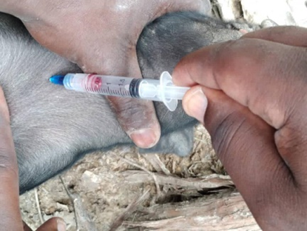
Methodology
Collected several ASF outbreak samples
Identified positive viruses using PCR
Developed a cell-line from domestic pigs (TDF submitted for IPR)
Infected domestic pig cell line with 5 viruses for 5-7 days

Slide 20
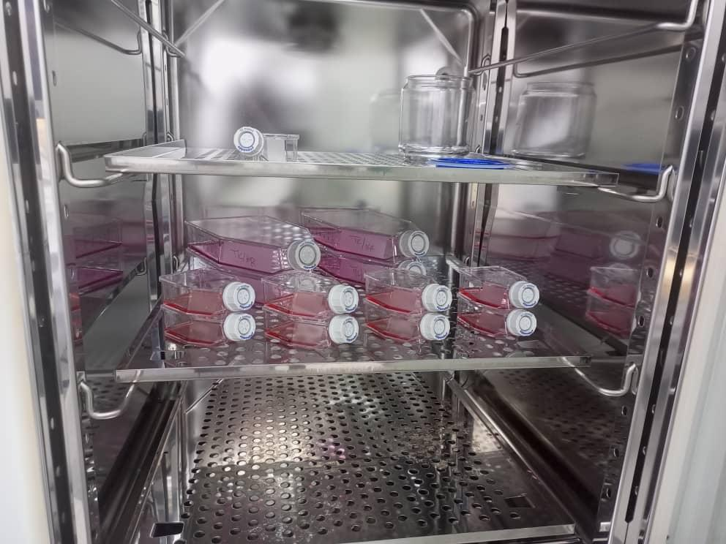
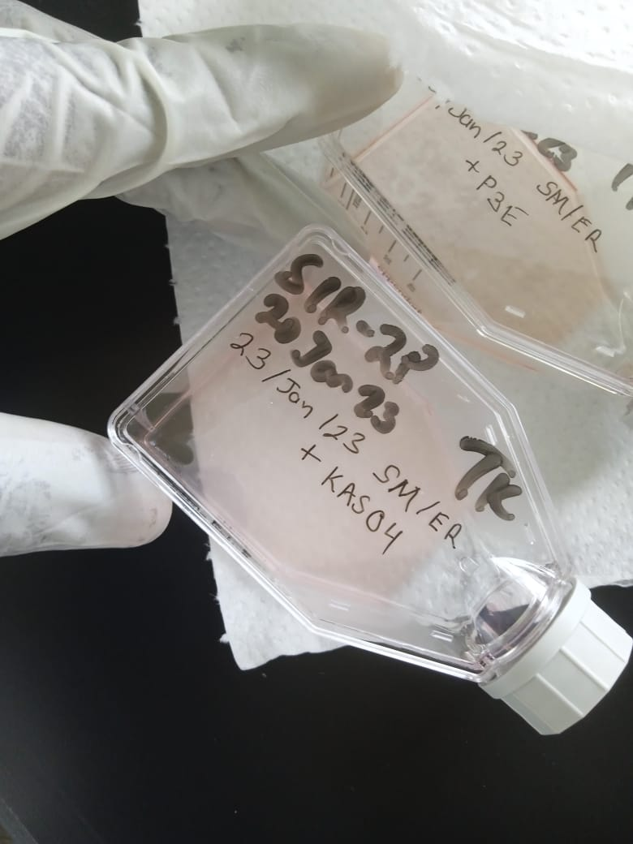
Methodology
Incubation of ASF viruses

Slide 21
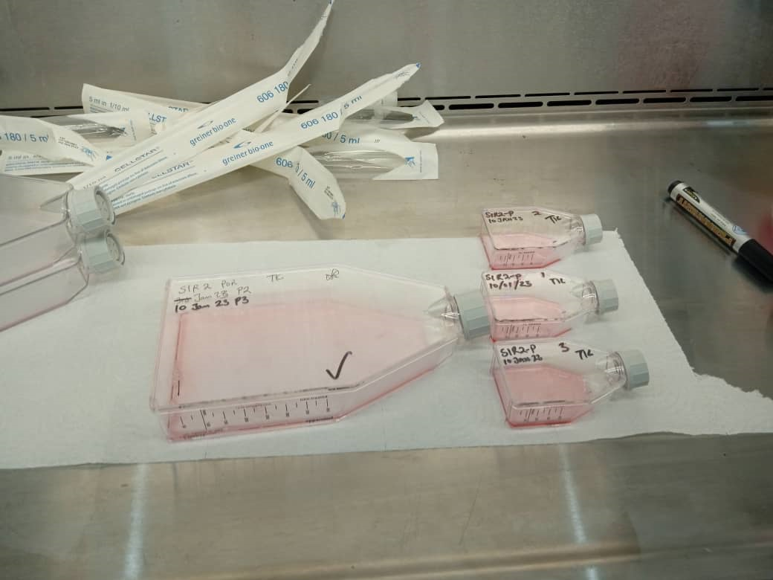
Infection and isolation of ASFV in Uganda
Seeding of T25 flasks with selected cell line before infection with ASFv

Slide 22
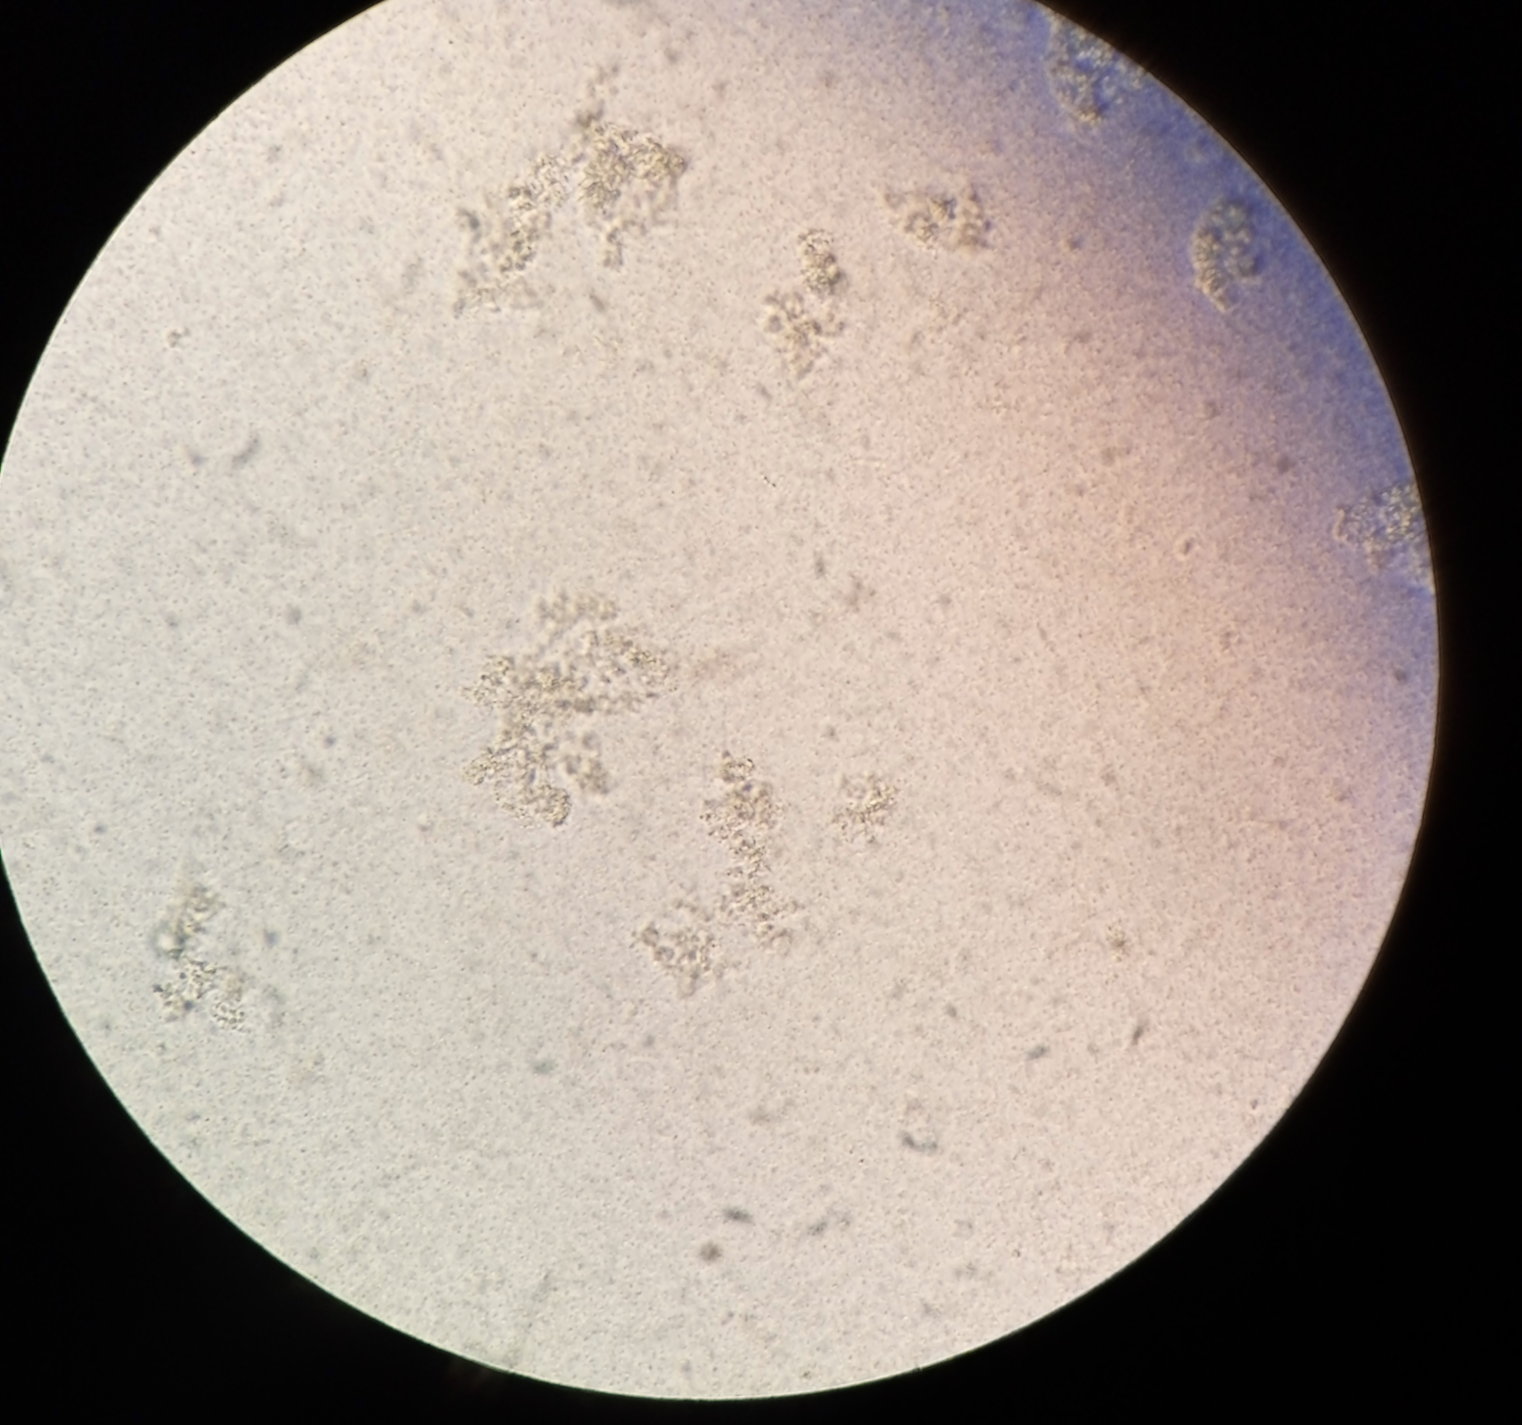
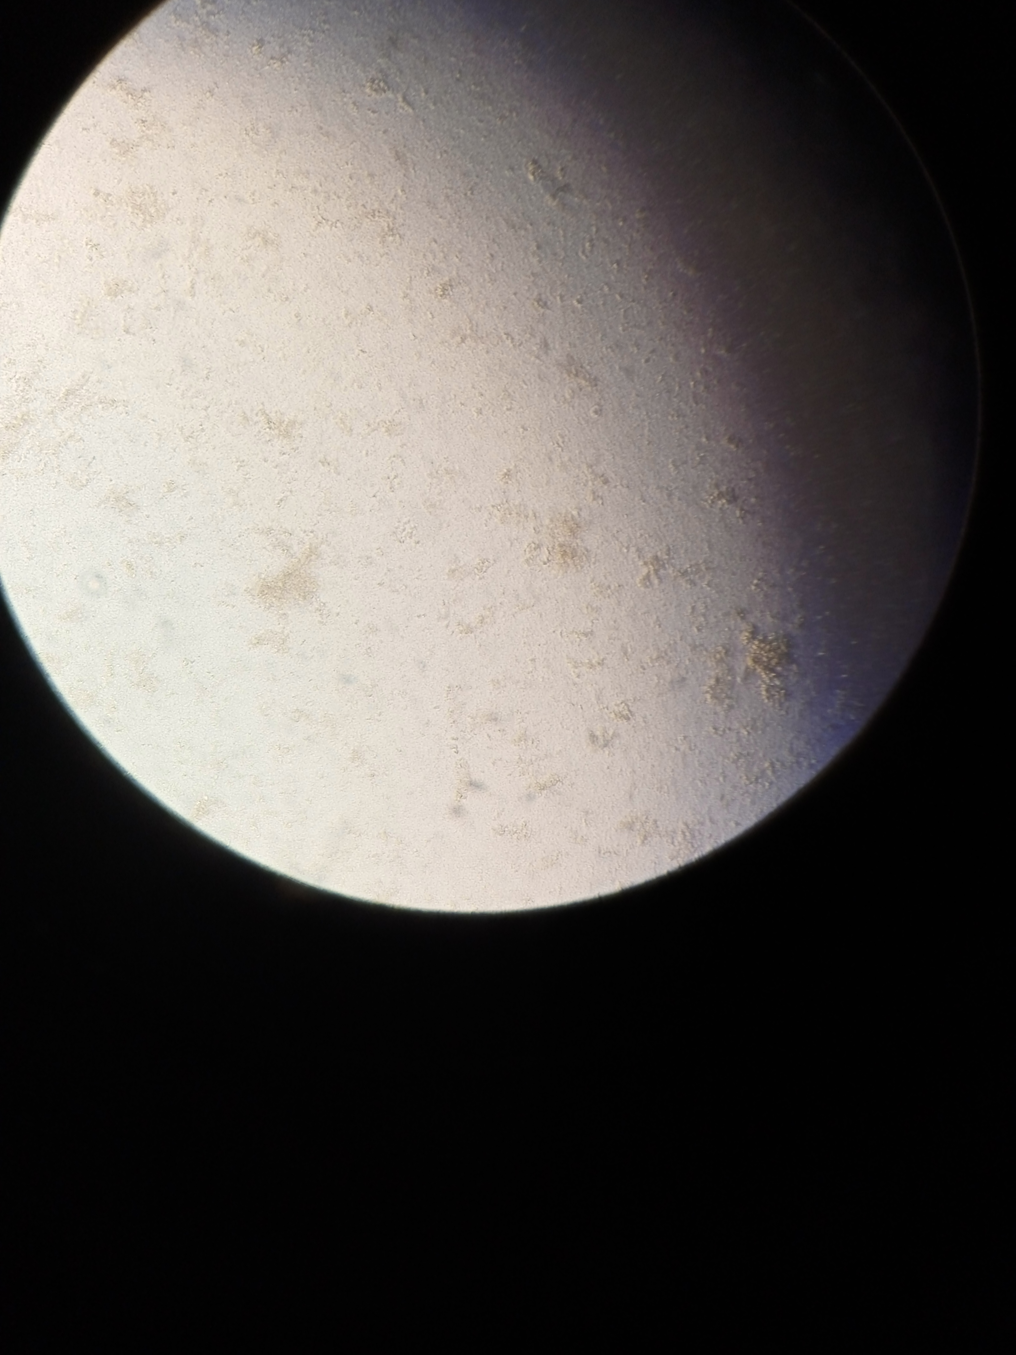
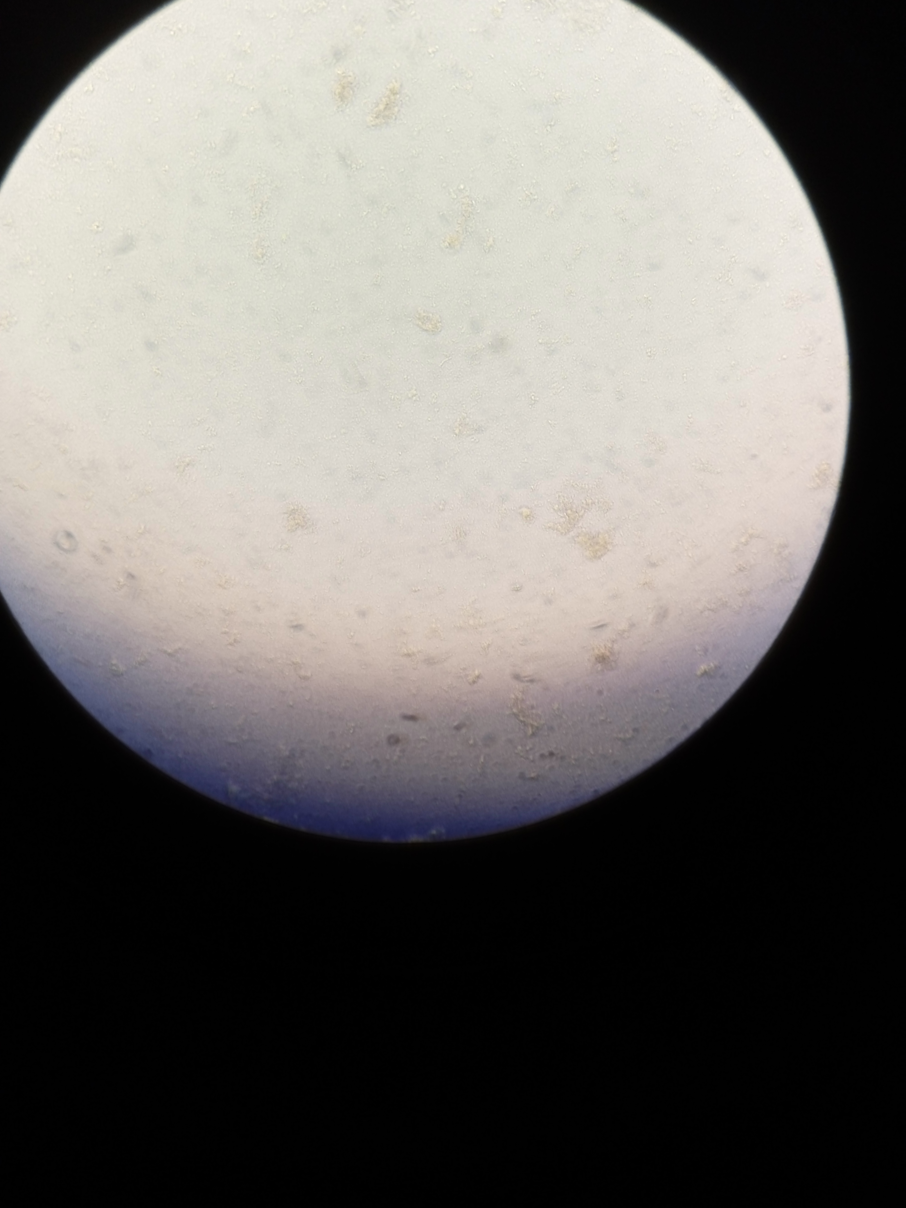
Results - Isolation of ASF viruses
Namayingo virus
Bunyangabu virus
Mukono virus
Plaques seen as shown under the red circles

Slide 23
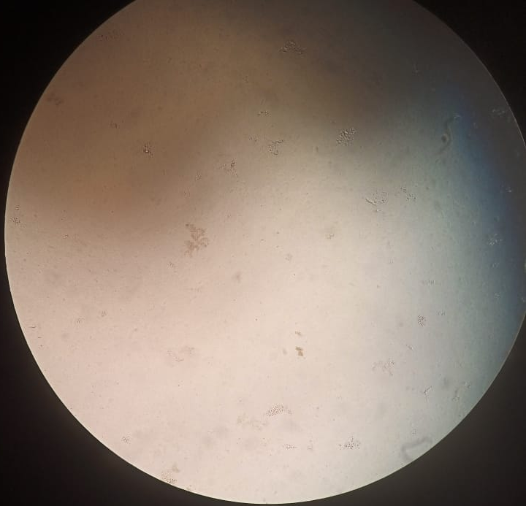
Isolation of ASF viruses
Kasese virus
Plaques seen as shown under the red circles

Slide 24
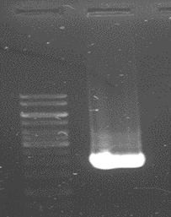
ASF Vaccine development work at NaLIRRI
pUC19 vector plasmid confirmation
Or Inactivated viruses option?
VS

Slide 25
Discussion
From 21 PCR-positive viruses, we selected 5 for isolation on the new selected cells
4 viruses from different regions in Uganda have been isolated as shown
1 more virus still being cultured

Slide 26
Conclusion
Our team has isolated 5 African Swine Fever Viruses using cell-culture in Uganda
Current efforts involve:
Purifying 5 viruses
In-vitro plaque titrations to determine titres, growth kinetics
Whole genome sequencing of 5 viruses
Inactivation as vaccine models
pUC19-deletion as live-attenuated vaccine models
Animal trials

Slide 27
Conclusion
Manuscript under preparation
Cell-culture mediated isolation of African Swine Fever field viruses for vaccine production in Uganda
Samuel Mulondo ¹, Ezinga, Richard ¹; Daisy, Iwutung ¹, Kabaka, Richard, M ¹; Moses Tefula Dhikusooka ¹; Swidiq Mugerwa ¹ ; Kabuuka, Tonny ^{1,} #

Slide 28
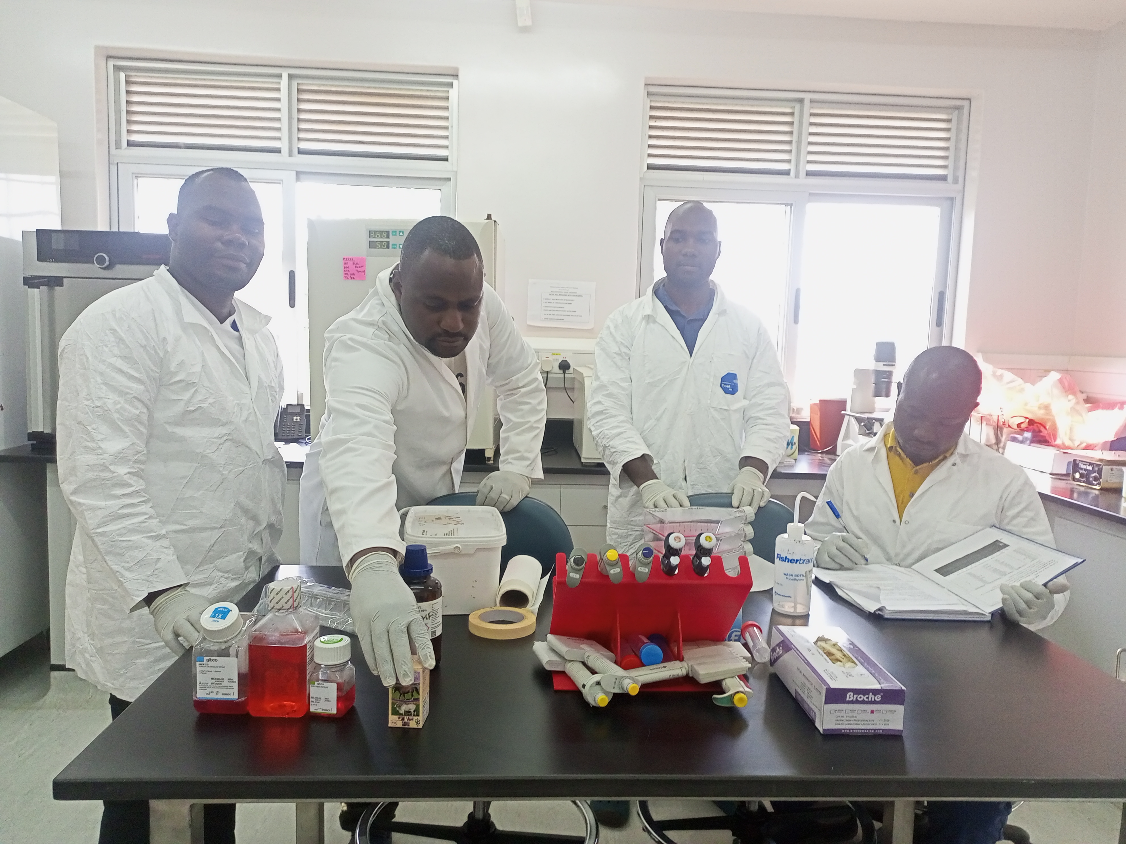
Acknowledgement
Government of Uganda, NARO-NaLIRRI

